Slide 1
6MMCS002W Digital Marketing, Social Media and Web Analytics
Week 9 – Google analyticS, Part b
Dr Vassiliki Bouki
boukiv@wmin.ac.uk

Slide 2
Google Analytics
Last week we discussed:
How to set up a google analytics account and connect your site; how to get access to “demo account” with real data
The terminology used
The main interface and the admin section
The meaning of terms “metric” and “dimension” in Google Analytics reports.
This week we will go through the reports we create in Google Analytics, how we create more advanced reports by combining dimensions and metrics, as well as further functionality of Google Analytics.

Slide 3
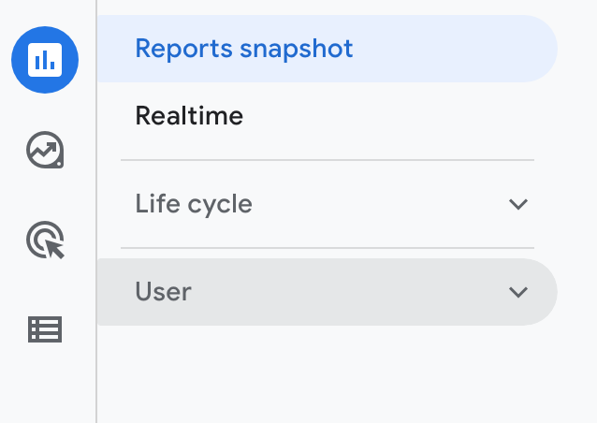
Google Analytics
In the reports section, there are the following sub-sections:
Reports Snapshots
Real Time
Life cycle
User
“Reports Snapshots” is a way to present information – we’ll discuss it at the end
“Real Time” allows us to monitor activity in the site / app, as it happens (discussed last week & used in last tutorial to confirm connection with the site)
Reports are mainly created in the sections: “Life cycle” and User
In the next slides, we’ll discuss them in details

Slide 4
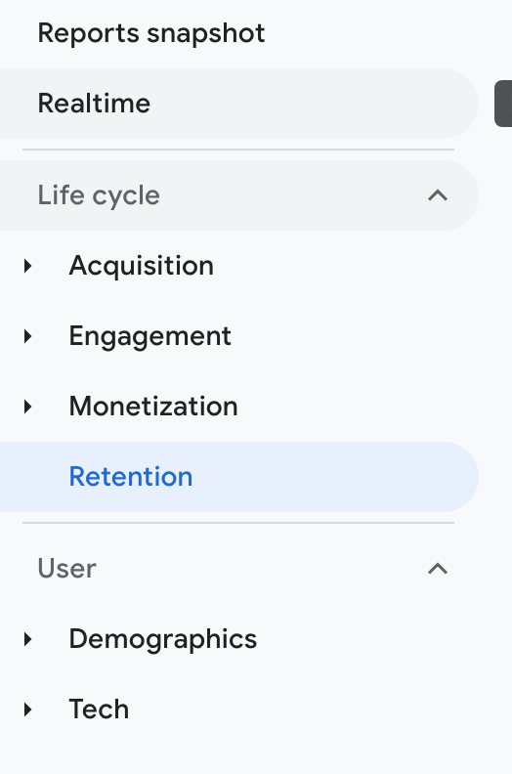
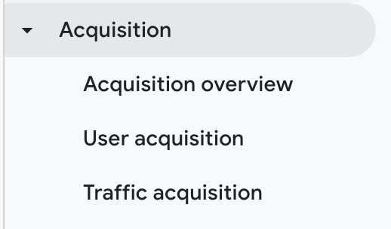
Google Analytics – Reports – Acquisition
Acquisition:
Acquisition reports: how people find your website.
The reports present data based on the source and medium of your users, along with other acquisition dimensions. There are dedicated reports for your paid traffic from Google Ads, organic traffic from Google (if you have linked your Google Search Console account), traffic from social networks and traffic from custom campaign tags.
https://www.lovesdata.com/blog/google-analytics-glossary

Slide 5
Google Analytics – Reports – Acquisition
Most common traffic dimensions:
Organic Search - Traffic from a search engine. If focusi on optimizing pages for search engines, this is an important channel to watch.
Display - Site found by clicking on an ad that you ran on another website. Common generators: Banner ads
Direct - Traffic came to your site by entering your URL directly into the address bar of browsers. Keep an eye on this one if you've been running offline or traditional media ads like print, TV, or radio, (they require audiences to remember and type your URL.
Referral - This traffic followed a backlink from another website to yours (if it doesn't fall under one of the other categories eg paid)
Paid Search - this traffic comes from your paid search ads which appear in the search results of Bing, Google etc
Social - Traffic generated from people who find your page through an associated social media account.
Email - This traffic clicked on links from email campaigns, follow up emails, and even email signatures;
Other - If GA greets your web traffic with a shrug emoji, they'll throw it in this channel.
(from: https://dashthis.com/blog/google-analytics-display-traffic/)
For full list see: https://support.google.com/analytics/answer/11080067

Slide 6
Google Analytics – Reports – Acquisition
User acquisition:
How new users arrived to your site
The User acquisition report shows data about new users. The traffic dimensions, like medium and source, in the report include the words "First user" to indicate that the traffic dimensions are about first-time users. For example, "First user medium" is the channel by which new users arrive on your site or app. (https://support.google.com/analytics/answer/10999979?hl=en)

Slide 7
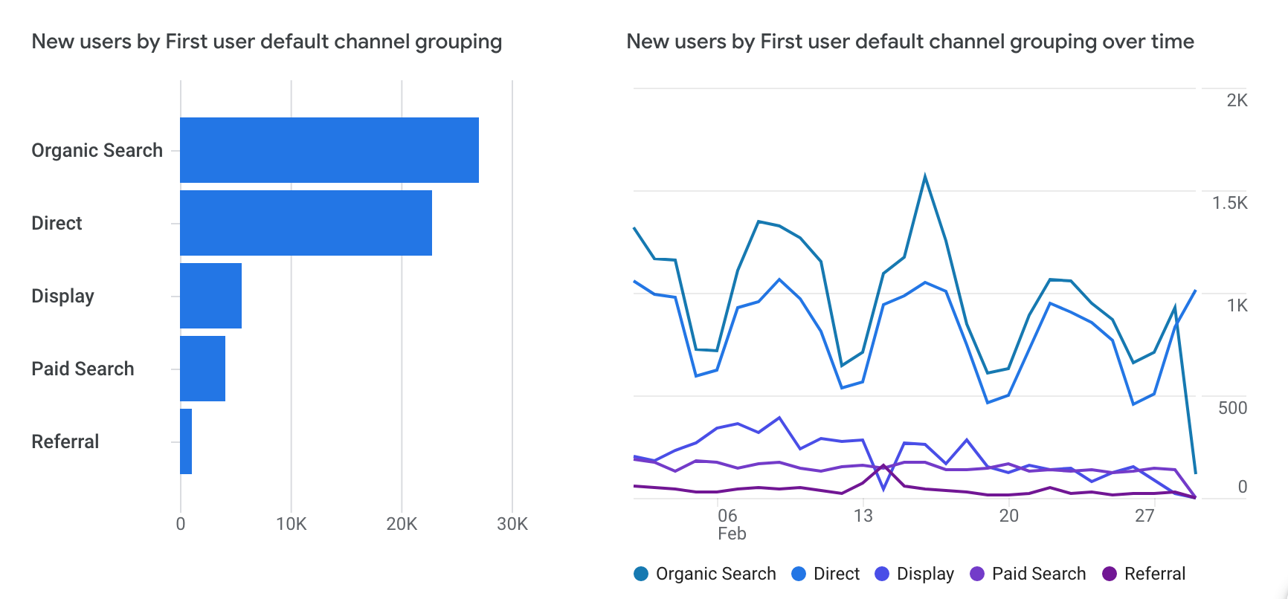
Google Analytics – Reports – Acquisition
User acquisition reports; notice the phrase “by first user”.

Slide 8
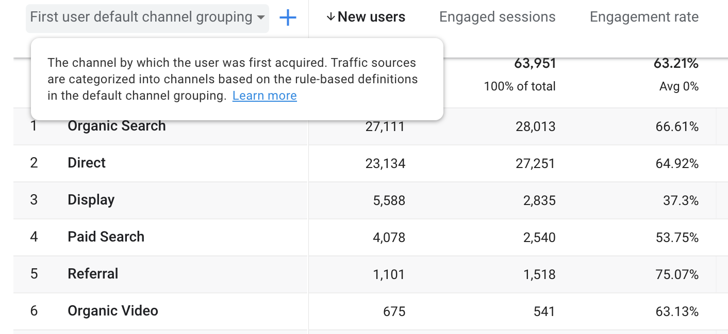
Google Analytics – Reports – Acquisition
Metrics
(numbers)
Dimensions
(names)
User acquisition report
Row: dimensions; columns: metrics. First metric: New users
Add dimension by clicking the “+” symbol next to main dimension

Slide 9
Google Analytics – Reports – Acquisition
Traffic acquisition:
From which channels sessions was generated
The Traffic acquisition report shows data about new sessions. The traffic dimensions, like medium and source, in the report include the word "Session" to indicate that the traffic dimensions are about new sessions. For example, "Session medium" is the channel by which new and returning users arrive on your site or app. (https://support.google.com/analytics/answer/10999979?hl=en)
How does “traffic acquisition” (sessions) differ from “user acquisition” (new users)?
“user acquisition” is about “new users” (the first time a user arrives in the site)
“traffic acquisition” is about “sessions” (session=a single visit)
One user could initiate more than one session

Slide 10
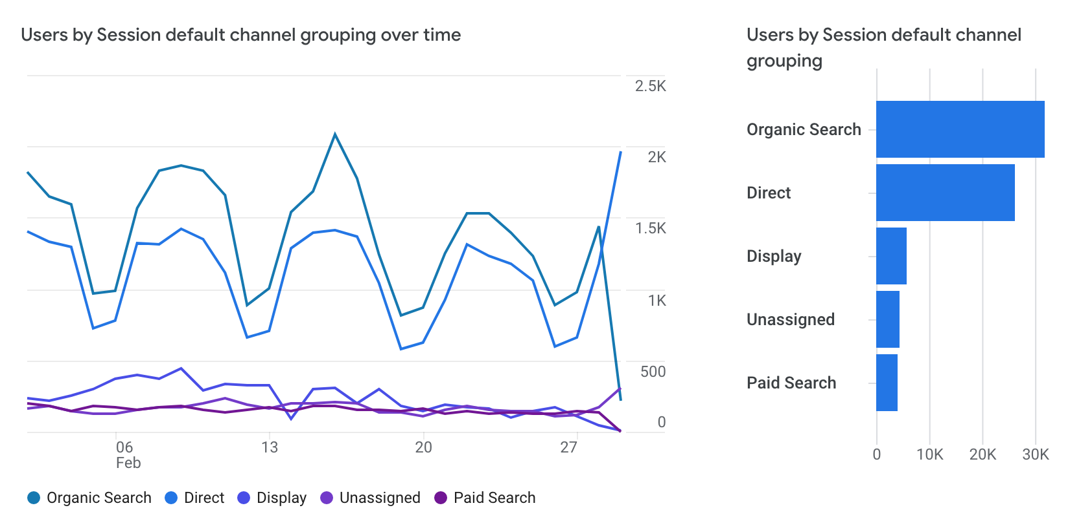
Google Analytics – Reports – Acquisition
Traffic acquisition reports; notice the phrase “by session”.

Slide 11
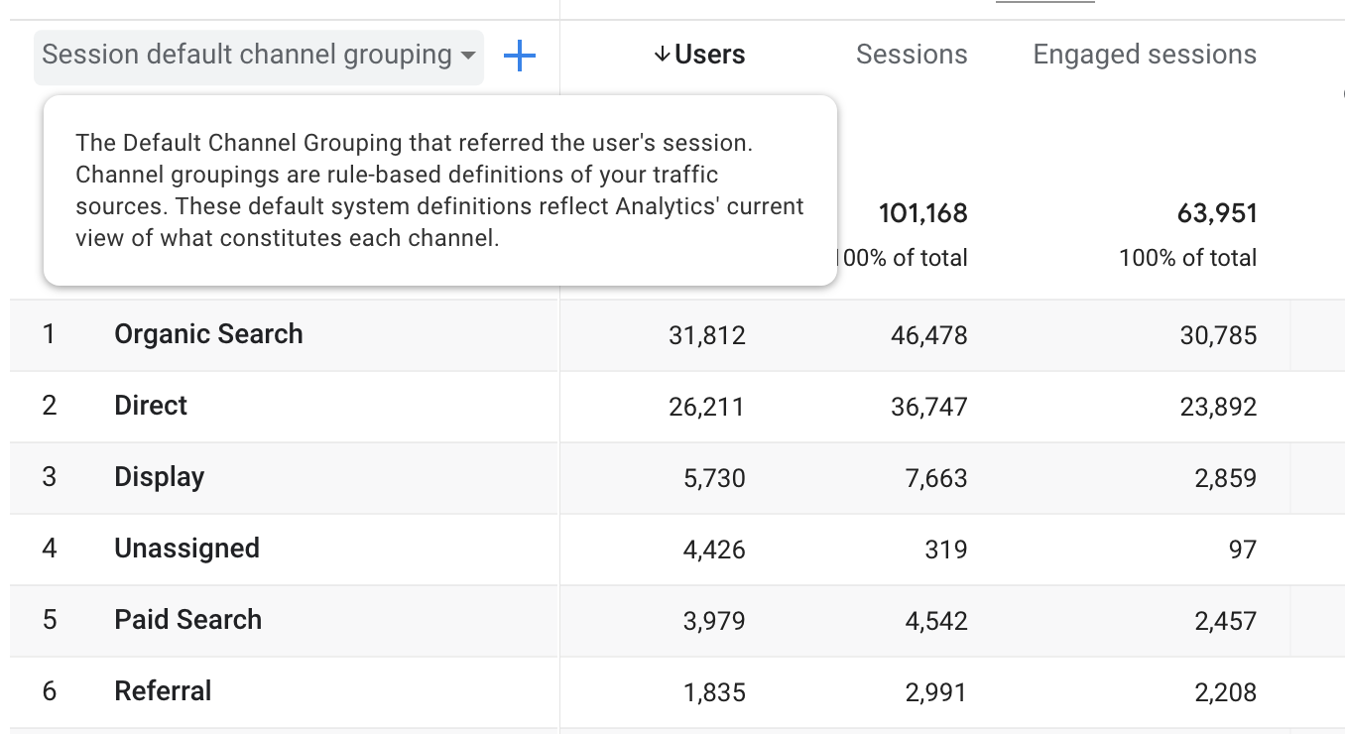
Google Analytics – Reports – Acquisition
Metrics
(numbers)
Dimensions
(names)
Traffic acquisition report
Row: dimensions; columns: metrics – first metric: Users
Add dimension by clicking the “+” symbol next to main dimension

Slide 12
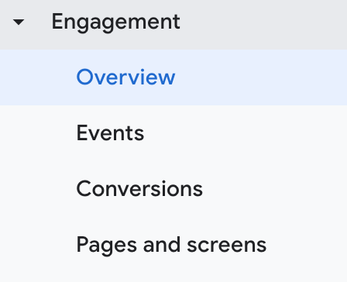
Google Analytics – Reports – Engagement
Engagement:
“simple” definition: what the user does in your site – how much engaged the user is in your site
“Official” definition: The user engagement metric shows the length of time that your app screen was in the foreground or your web page was in focus. When your site or app is running but no page or screen is displayed, Analytics doesn't collect the user engagement metric. The user engagement metric can help you understand when users actively use your website or mobile app.
https://support.google.com/analytics/answer/11109416?hl=en

Slide 13
Google Analytics – Reports – Engagement
Engaged Sessions
For a session to be considered engaged, a visitor has to do one or more of the following:
Engage actively on your website or mobile app for over 10 seconds.
Have two or more screen or page views.
Fire a conversion event.
In the past GA used the term “bounce rate” – rate of 1-page visits. In GA4, “bounce rate” is considered as one of the parameters of “engaged sessions” (number 2 above).
The term “bounce rate” is still used widely in Analytics.

Slide 14
Google Analytics – Reports – Engagement
Engagement Rate: Number of engaged sessions / total number of sessions.
Engaged Sessions Per User: Number of engaged sessions / total users on your site and mobile apps.
Engagement Time: The sum total of engagement time on your website and mobile apps.
(https://www.datadrivenu.com/google-analytics-4-engagement-rate)
Average Engagement Time: engagement time / active user
Average Engagement Time per session: Engagement time / sessions

Slide 15
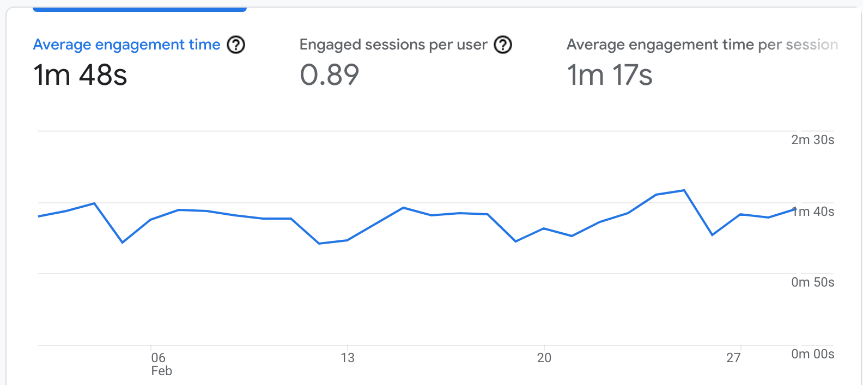
Google Analytics – Reports – Engagement
Engagement Overview

Slide 16
Google Analytics – Reports – Engagement, Events
Events
Actions that happen in the website/app, are collected by Google Analytics.
GA4 code collects all data as events, e.g. “page views” is an event.
There are 3 categories of events:
automatic
recommended
custom events
https://www.lovesdata.com/blog/google-analytics-4-events

Slide 17
Google Analytics – Reports – Engagement, Events
Automatic events
Events tracked automatically include:
The first_visit event is collected the first time someone visits your website. This event is also used to calculate the ‘New Users’ metric in your reports.
The page_view event is used to report on the page the user is viewing.
The session_start event is used to determine when the user’s session started. A new session_start event is triggered when there is a period of inactivity of 30 minutes.
The user_engagement event can be collected periodically and is used to report when someone has spent at least 10 seconds on your website.

Slide 18
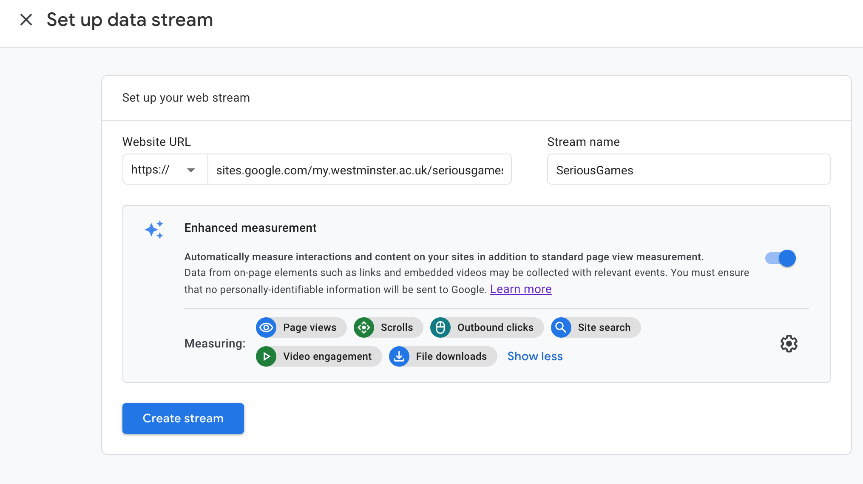
Google Analytics – Reports – Engagement, Events
Automatic events and enhanced measurement
“Enhanced measurement” feature to collect additional data automatically
When you set up your account, you were asked to select if you wish to activate “enhanced measurement”

Slide 19
Google Analytics – Reports – Engagement, Events
Recommended events:
Google’s list of recommended events: https://support.google.com/analytics/answer/9267735
Custom events:
You can modify existing events or create your own events via the interface: https://support.google.com/analytics/answer/10085872?hl=en#zippy=%2Cin-this-article
Important notice: In the “demo” site you cannot add your custom events; you can do it in your own site GA.
Important notice 2: “events” are different GA4 than in previous Google Analytics versions.

Slide 20
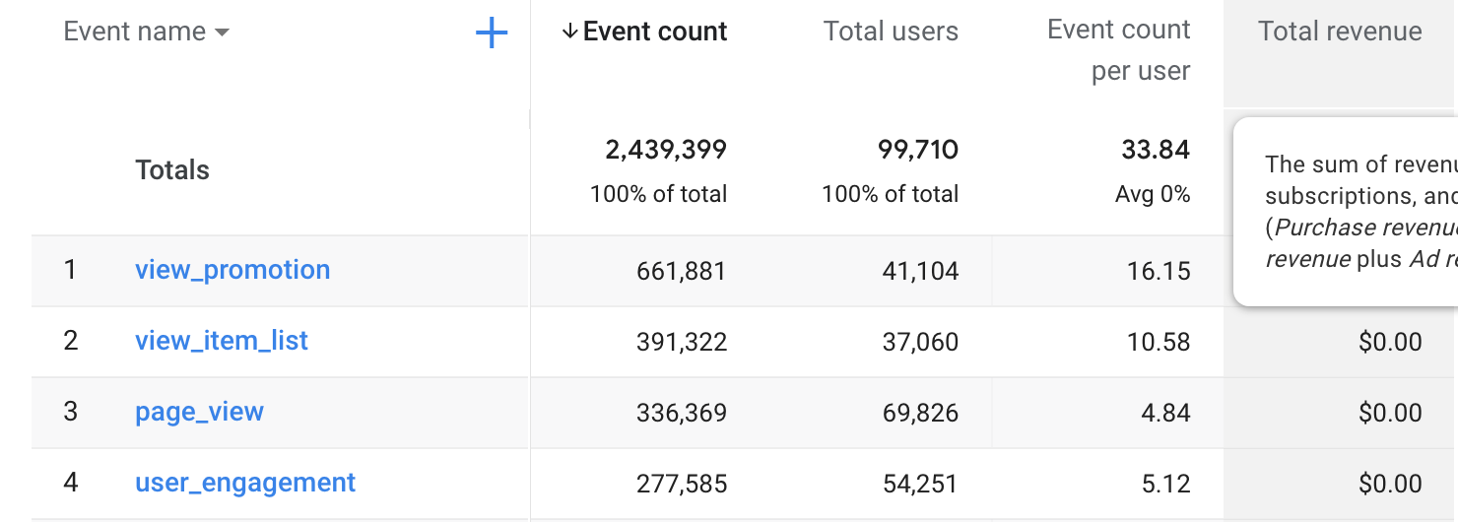
Google Analytics – Reports – Engagement, Events
Custom events
Automatic events
Example of events report

Slide 21
Google Analytics – Reports – Engagement, Conversions
Conversions are user activities that contribute to the success of your business.
Apparently, each company could consider different actions as “conversion”, for example: purchase (the most common conversion); register to a newsletter; download a file/game
Conversions are events.
You should mark up an event (automatic or custom event) as conversion
https://support.google.com/analytics/answer/9267568?hl=en#zippy=%2Cin-this-article
Important notice: In the “demo” site you cannot change an existing conversion or define a new conversion; you can do it in your own site GA.

Slide 22
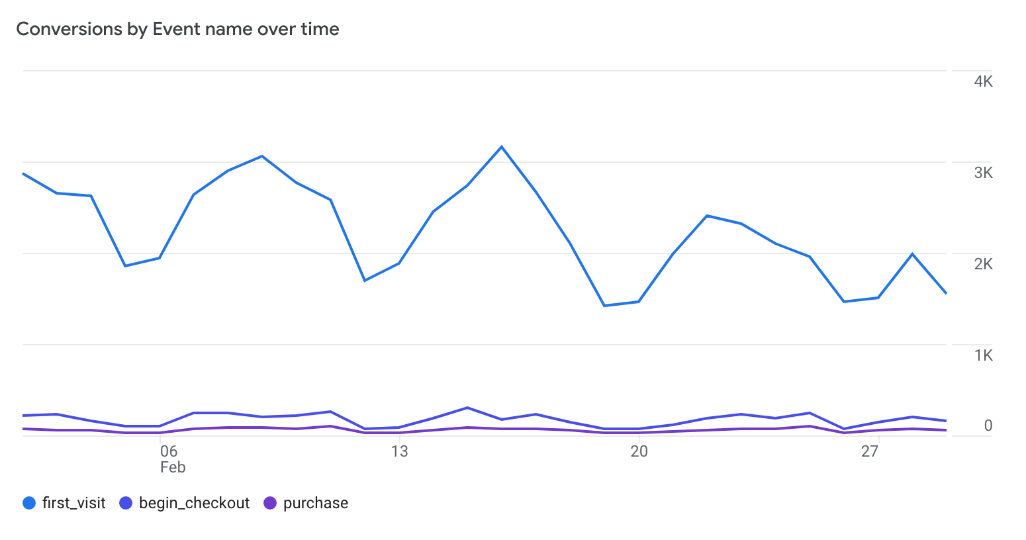
Google Analytics – Reports – Engagement, Conversions
Example of conversion report; the events at the bottom have been defined as “conversion”

Slide 23
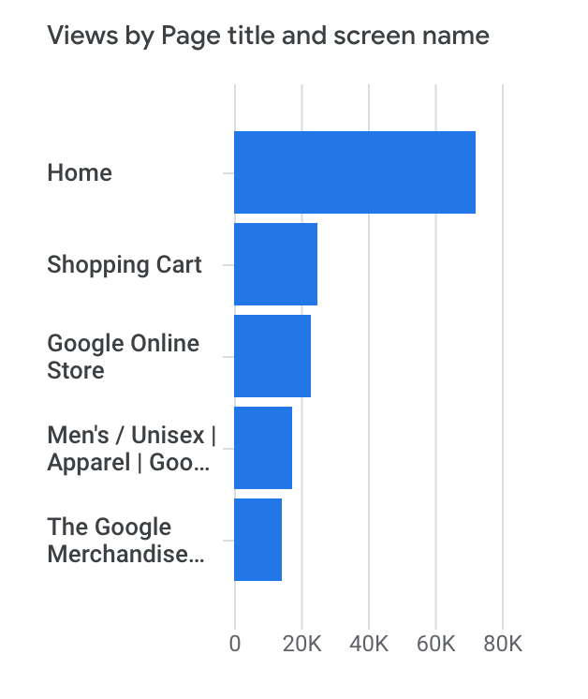
Google Analytics – Reports – Engagement, pages & screens
Pages and screens
Page view is an automatic event
When you first access the “Pages and screens” in the ”Engagement” section, you'll see your data broken down according to page title (for web sites) and screen class (for apps).
This means you're looking at all the pages on your site, broken down by the web page title and the developer-supplied screen name.

Slide 24
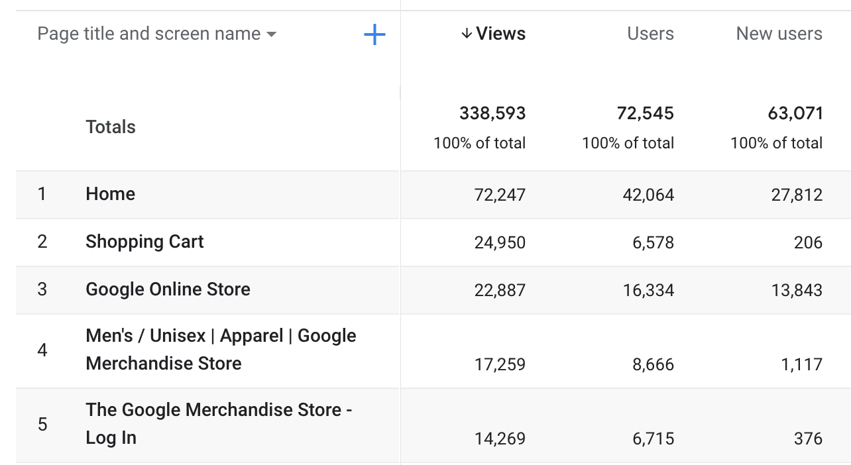
Google Analytics – Reports – Engagement, pages & screens
Metrics
(numbers)
Dimensions
(names)
The default property is : “page title and screen name”;
Metrics: “Views”, “Users”, “New Users”
Please notice you can change the default property and/or can add a secondary property. Click on the arrow next to property name and the “+” symbol.

Slide 25
Google Analytics – Reports- Monetization
Monetization reports are directly related to e-commerce goals that a company sets. They should be set up in relation to company’s business plans.
“The Monetization topic lets you measure purchase, ad, and subscription revenue, see how users interact with items (such as the products you sell), and measure steps in the checkout funnel. The reports can help you understand consumer behavior and enhance your monetization strategy.” (https://support.google.com/analytics/answer/9786881?hl=en)

Slide 26
Google Analytics – Reports – Retention
The Retention topic helps you understand how frequently and for how long (over a period of time) users engage with your website or mobile app after their first visit. The topic also helps you understand how valuable users are based on the additional revenue you generate after their first visit.
(https://support.google.com/analytics/answer/11004084?hl=en)

Slide 27
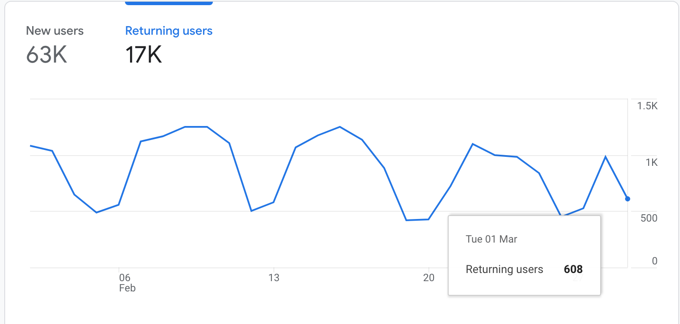
Google Analytics – Reports – Retention
The retention diagram above, shows the new and the returning users during the specific period of time
You need to click to each name, to change tab.

Slide 28
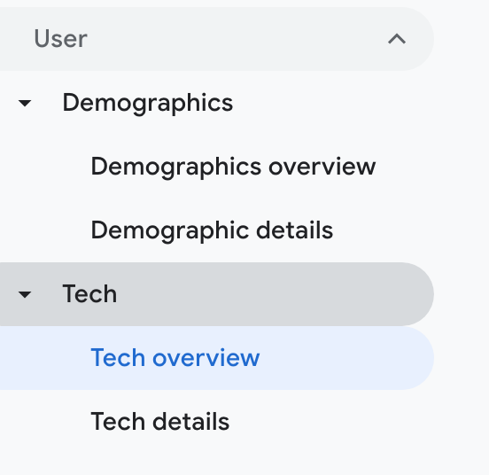
Google Analytics – Reports – User
Finally the section “User” we get:
Demographic information about the user (such as: Country, City, Language)
Technical information (such as platform, operation system, browser, device etc)

Slide 29
Google Analytics – Reports – Reports snapshot
The last option we discuss is “Reports snapshot” (the first option in the Reports section”
“Reports snapshot” is a way to present several reports on the screen. You can customize your snapshot; it could consists of several reports / customized reports.
Customize “Reports snapshot”:
https://support.google.com/analytics/answer/10659091

Slide 30

Google Analytics – Reports
Few more very useful tools:
Share this report: You can export a report as pdf file or generate a link that can be used by anyone who has access to the property
Insights: “Analytics Intelligence” pre-defined questions you could ask
Customize reports: There are several pre-defined cards (combinations of dimensions and/or metrics). You could select up to 16 cards to save in your account.
When you create a customized report, you could add in the current snapshot or create a new “reports snapshot”
Customize reports option is not available in “demo site” – it is available for your own site.
````````````````````
`

Slide 31
Final remarks
Google Analytics is a sophisticated tool that offers a huge amount of information.
In the last two lectures we covered the basic principles related to this tool.
There are many more things you could do with it.
You could explore the further functionality on your own.

Slide 32
Next week
So far we have seen what “Analytics” is, how to collect information using Google Analytics and how to read the reports.
All the data we have collected so far are useless IF they are not translated to actions.
Next week we’ll see how to define a business plan and how to use GA to achieve business purposes.

